Slide 1
Synthesis of Novel Fenarimol Analogues as Drug Candidates for the Neglected Tropical Disease Mycetoma
Hung Phat Duong
13 November 2017

Slide 2
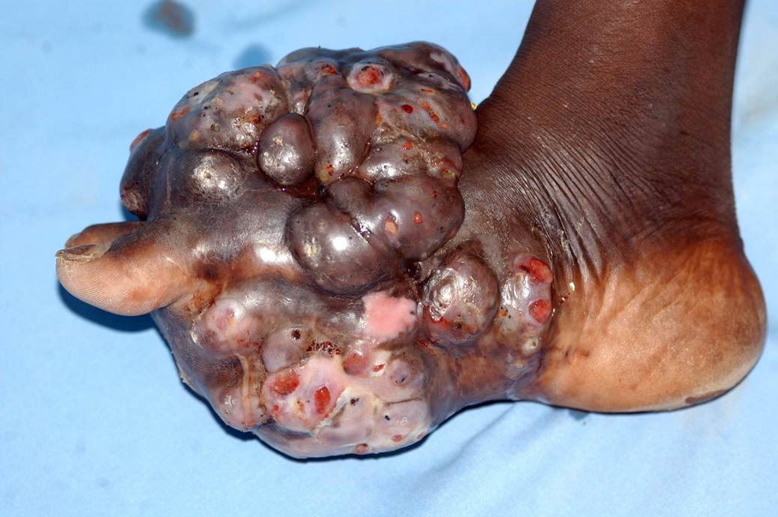
Mycetoma
fungus
masses/swelling

Slide 3
Mycetoma
fungus
masses/swelling
Subcutaneous infection
Sinus lesions
Granular discharge
WHO – Mycetoma http://www.who.int/buruli/mycetoma/en/ Image reproduced with permission from CC BY-NC-SA 3.0 CH license.

Slide 4

Mycetoma
fungus
masses/swelling
Subcutaneous infection
Sinus lesions
Granular discharge
WHO – Mycetoma http://www.who.int/buruli/mycetoma/en/ Image reproduced with permission from CC BY-NC-SA 3.0 CH license.

Slide 5
WHO – Neglected Tropical Diseases
Buruli Ulcer | Lymphatic Filariasis
Chagas Disease | River Blindness
Dengue Fever | Rabies
Guinea-Worm Disease | Schistosomiasis
Echinococcosis | Soil-transmitted Helminthiases
Foodborne Trematodiases | Cysticercosis
Sleeping Sickness | Trachoma
Leishmaniasis | Yaws
Leprosy | Mycetoma
New Guy
WHO – Mycetoma http://www.who.int/buruli/mycetoma/en/

Slide 6
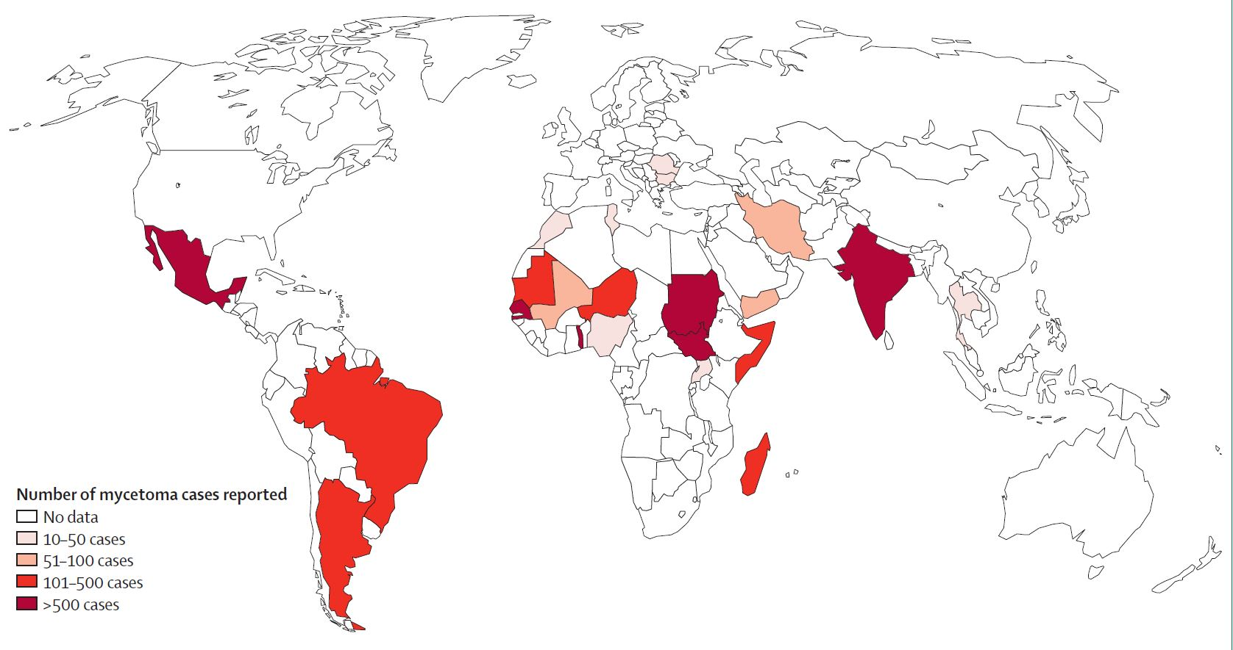
The Mycetoma Belt
Mexico
India
Sudan
South America
van de Sande, W. W. J., Global Burden of Human Mycetoma: A Systematic Review and Meta-analysis. PLoS Neglected Tropical Diseases 2013, 7 (11), e2550. Reproduced with permission from CC-BY-4.0 licence.

Slide 7
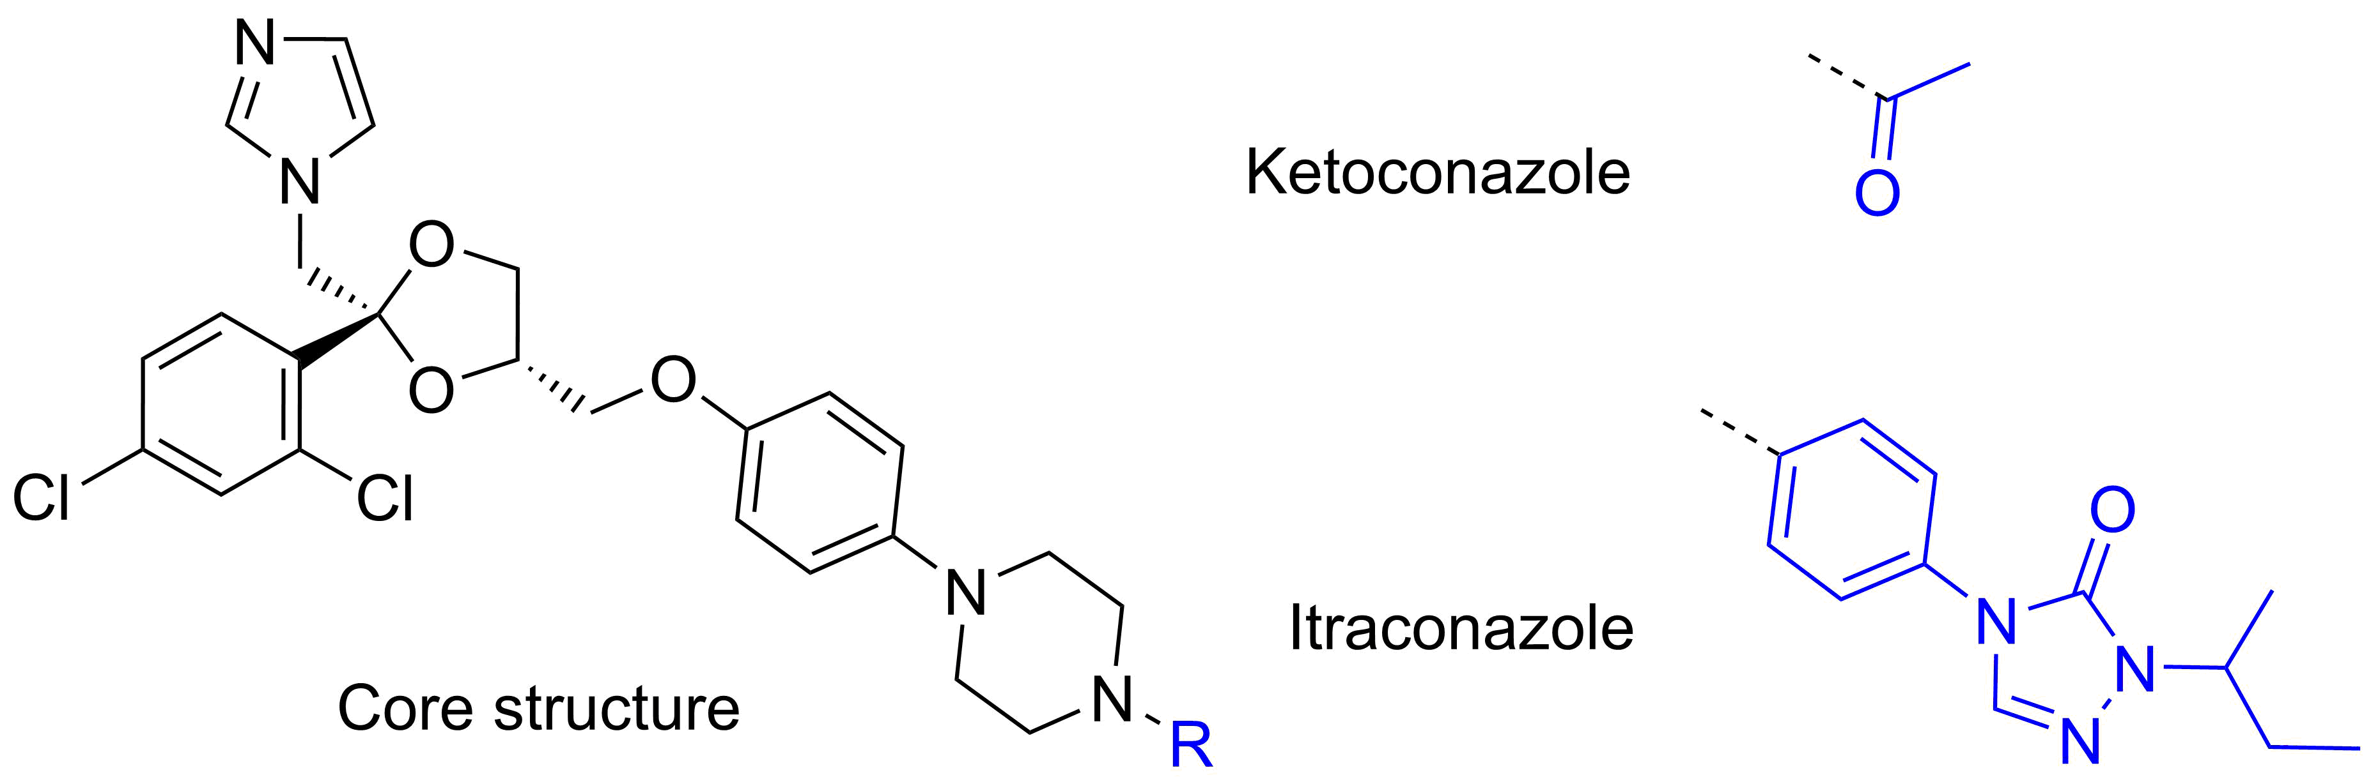

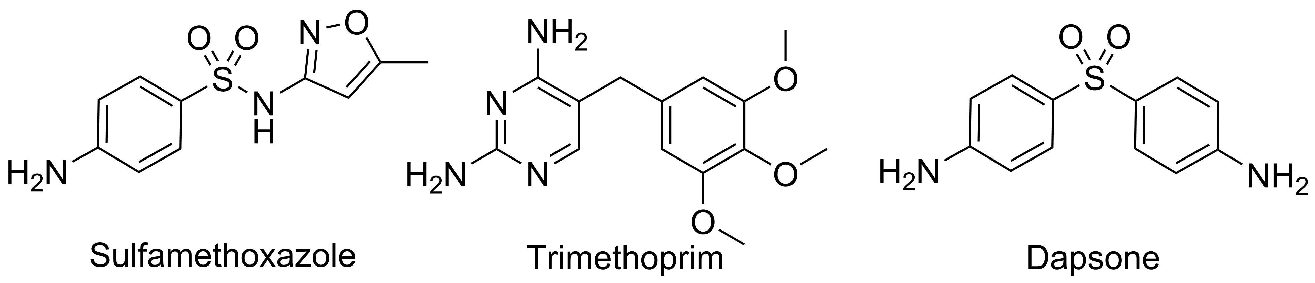

Mycetoma
The predicament
Bacterial
Fungal
Pathogen: Nocardia brasiliensis
Speed: Aggressive
Treatment: Antibiotics
Cured 90%
Pathogen: Madurella mycetomatis
Speed: Progressive
Treatment: Antifungals
Cured 25–35%
✓✓
✗✗
Zijlstra, E. E.; van de Sande, W. W. J.; Welsh, O.; Mahgoub, E. S.; Goodfellow, M.; Fahal, A. H., Mycetoma: a unique neglected tropical disease. The Lancet Infectious Diseases 2016, 16 (1), 100–112.

Slide 8

Mycetoma
The consequences
Fungal
Pathogen: Madurella mycetomatis
Speed: Progressive
Treatment: Antifungals
Cured 25–35%
✗✗
Zijlstra, E. E.; van de Sande, W. W. J.; Welsh, O.; Mahgoub, E. S.; Goodfellow, M.; Fahal, A. H., Mycetoma: a unique neglected tropical disease. The Lancet Infectious Diseases 2016, 16 (1), 100–112.

Slide 9


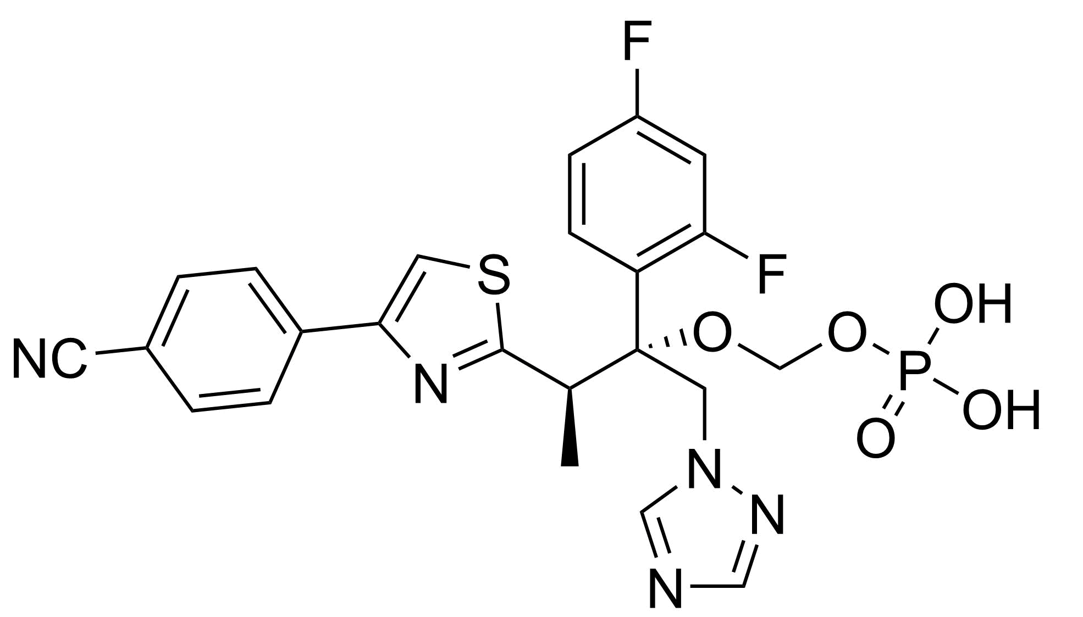
First Clinical Trial
Proof-of concept phase II superiority trial
Fosravuconazole
✓✓✓
DNDi Fosravuconazole Trial https://www.dndi.org/diseases-projects/portfolio/fosravuconazole

Slide 10
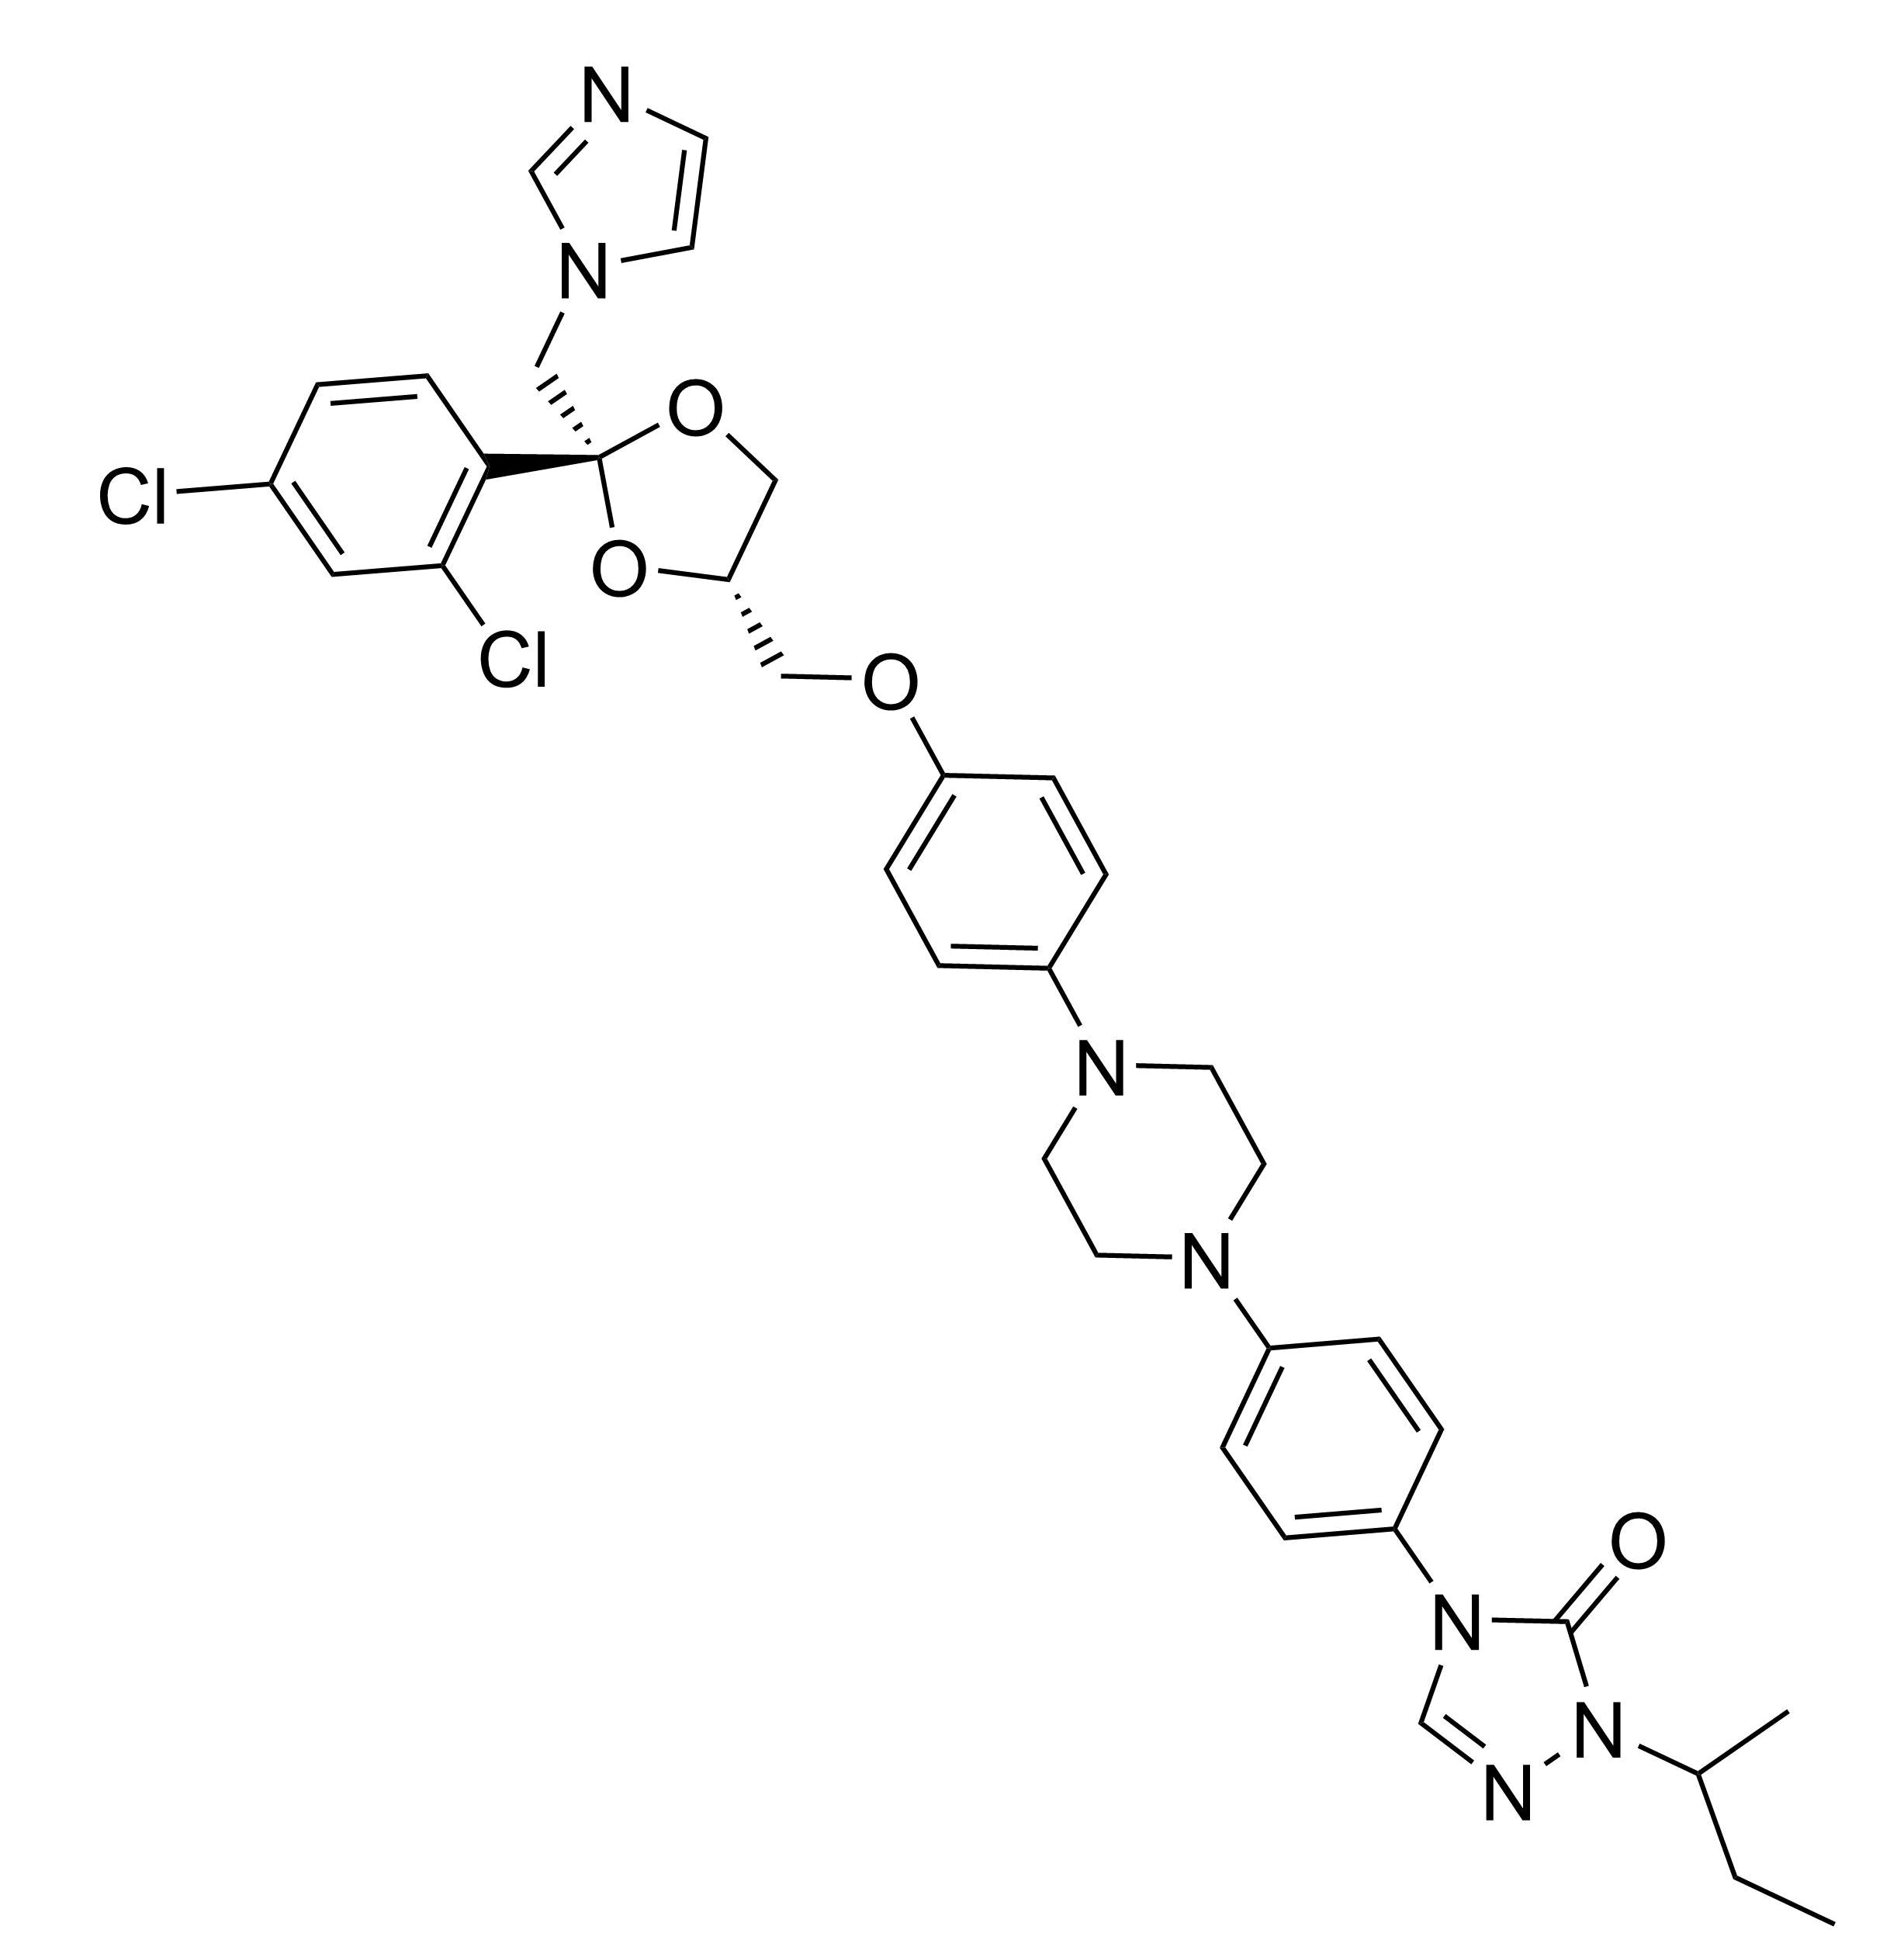

First Clinical Trial
Proof-of concept phase II superiority trial
Fosravuconazole
Itraconazole
✓✓✓
DNDi Fosravuconazole Trial https://www.dndi.org/diseases-projects/portfolio/fosravuconazole

Slide 11
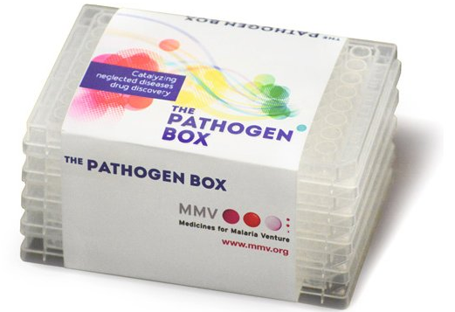

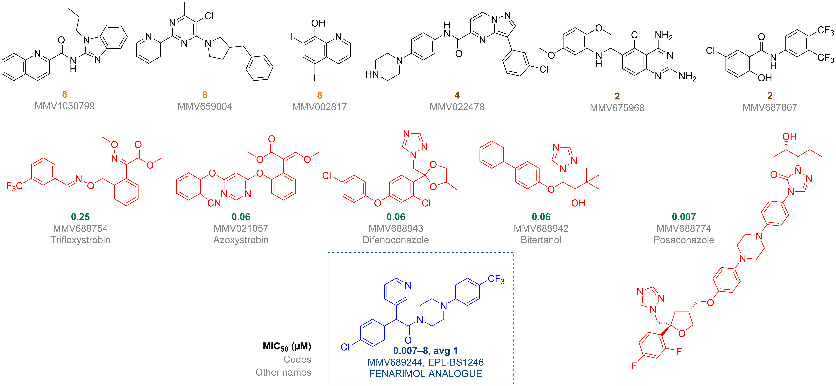
Pathogen Box Hits
The origin of this project
van de Sande 2017 (unpublished data)

Slide 12

Chagas Disease’s Fenarimol Analogue
Stability, low toxicity, moderate solubility
A typical fenarimol analogue
Keenan, M. et al. Analogues of Fenarimol Are Potent Inhibitors of Trypanosoma cruzi and Are Efficacious in a Murine Model of Chagas Disease. J. Med. Chem. 2012, 55 (9), 4189-4204

Slide 13
Chagas Disease’s Fenarimol Analogue
Stability, low toxicity, moderate solubility
Haem-iron binding motif
???
???
???
Metabolic Stability
Metabolic Stability
Keenan, M. et al. Analogues of Fenarimol Are Potent Inhibitors of Trypanosoma cruzi and Are Efficacious in a Murine Model of Chagas Disease. J. Med. Chem. 2012, 55 (9), 4189-4204

Slide 14
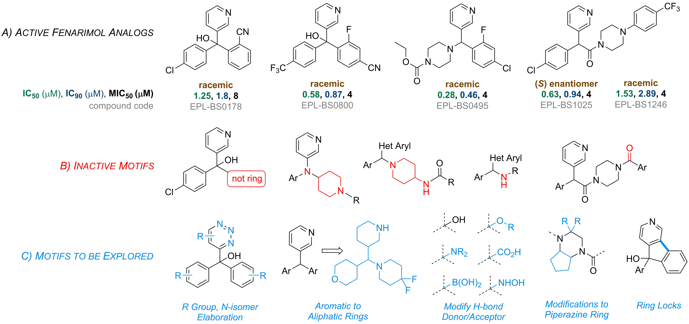
Initial Fenarimol Hits
Screening 40 diverse compounds from a library of 700 fenarimol analogues
van de Sande 2017 (unpublished data)

Slide 15
Initial Fenarimol Hits
Screening 40 diverse compounds from a library of 700 fenarimol analogues
van de Sande 2017 (unpublished data)

Slide 16
Initial Fenarimol Hits
Screening 40 diverse compounds from a library of 700 fenarimol analogues
van de Sande 2017 (unpublished data)

Slide 17
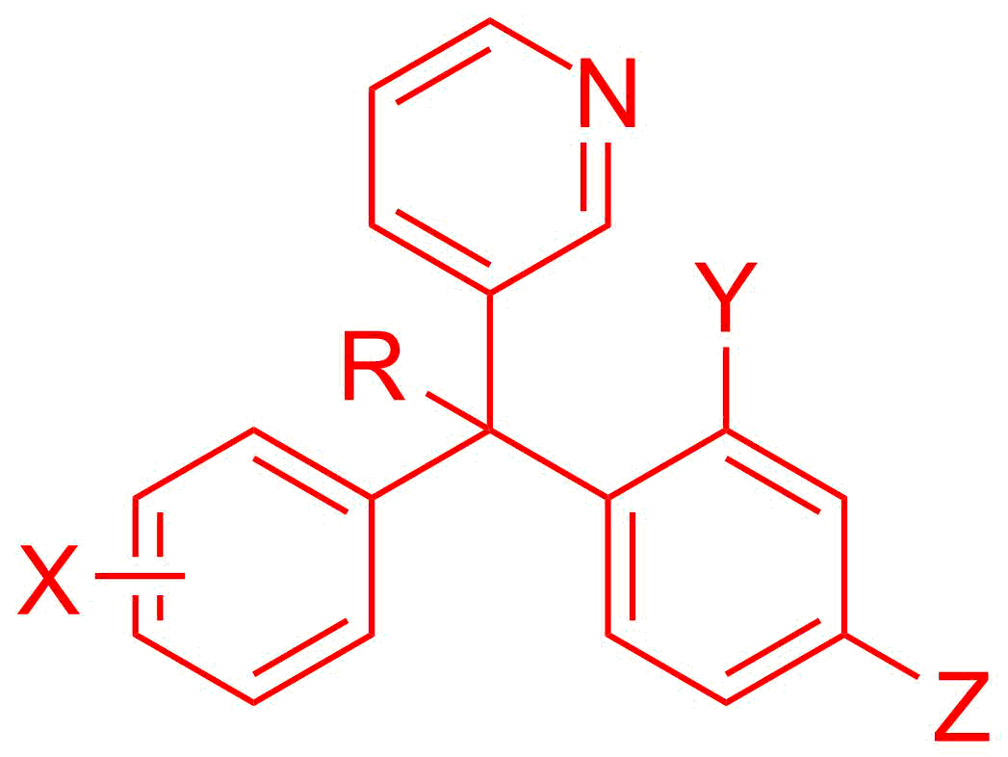
Aims
Resynthesise initial hits
Make novel analogues

Slide 18
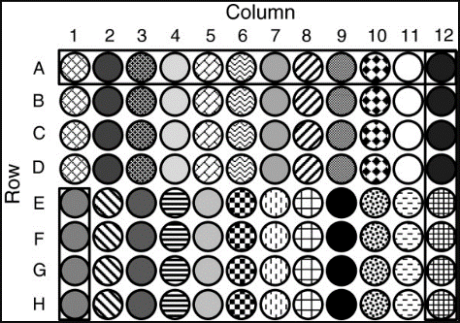
Aims
Resynthesise initial hits
Make novel analogues
Biological Evaluation
Results guide new synthesis

Slide 19


Aims
Resynthesise initial hits
Make novel analogues
Biological Evaluation
Results guide new synthesis
Public domain data
Open source platform

Slide 20
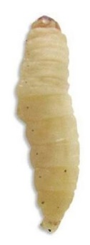
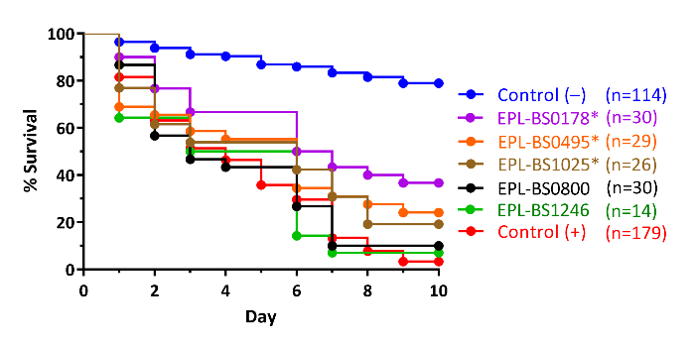




A Collaborative Effort
Asst. Prof. Wendy van de Sande
Me! ☺
.
Dr. Benjamin Perry
Assoc. Prof. Matthew Todd

Slide 21
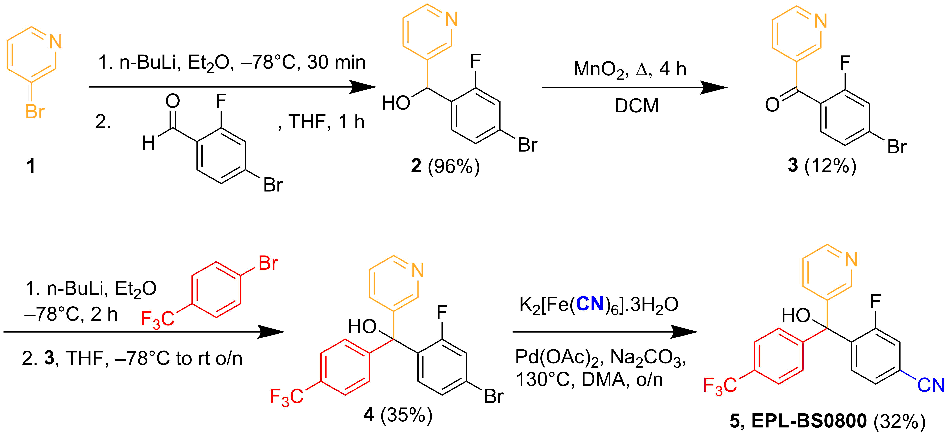
Synthesis
EPL-BS0800 resynthesis

Slide 22
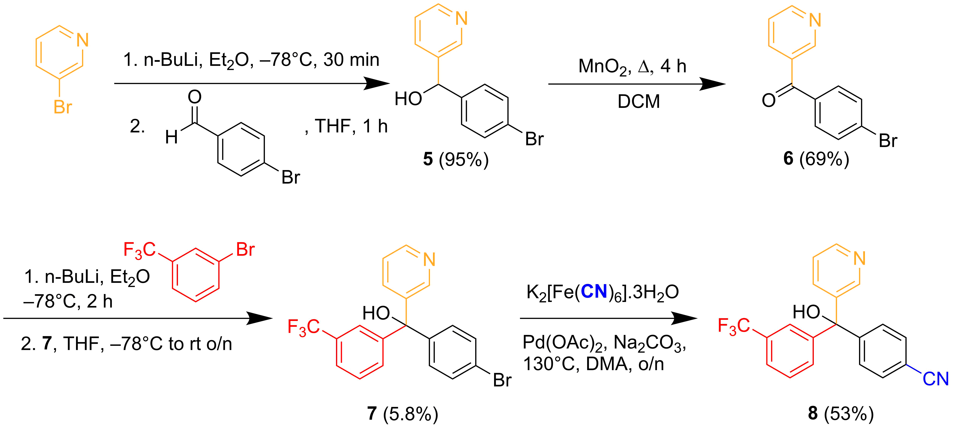
Synthesis
Novel EPL-BS0800 analogue

Slide 23
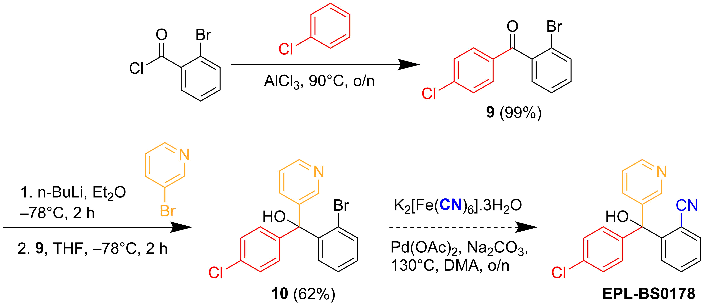
More Synthesis
EPL-BS0178 resynthesis

Slide 24
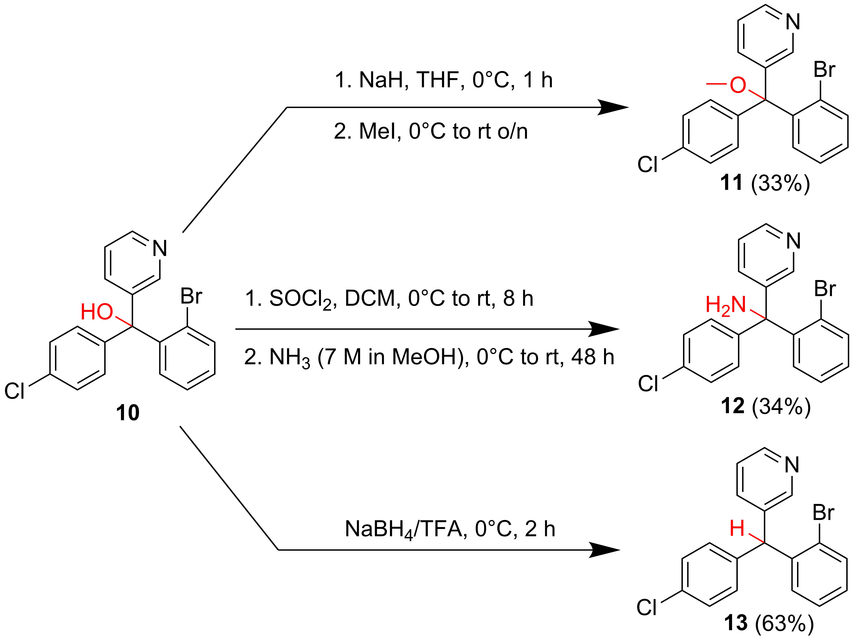
More Synthesis
Novel EPL-BS0178 analogues

Slide 25
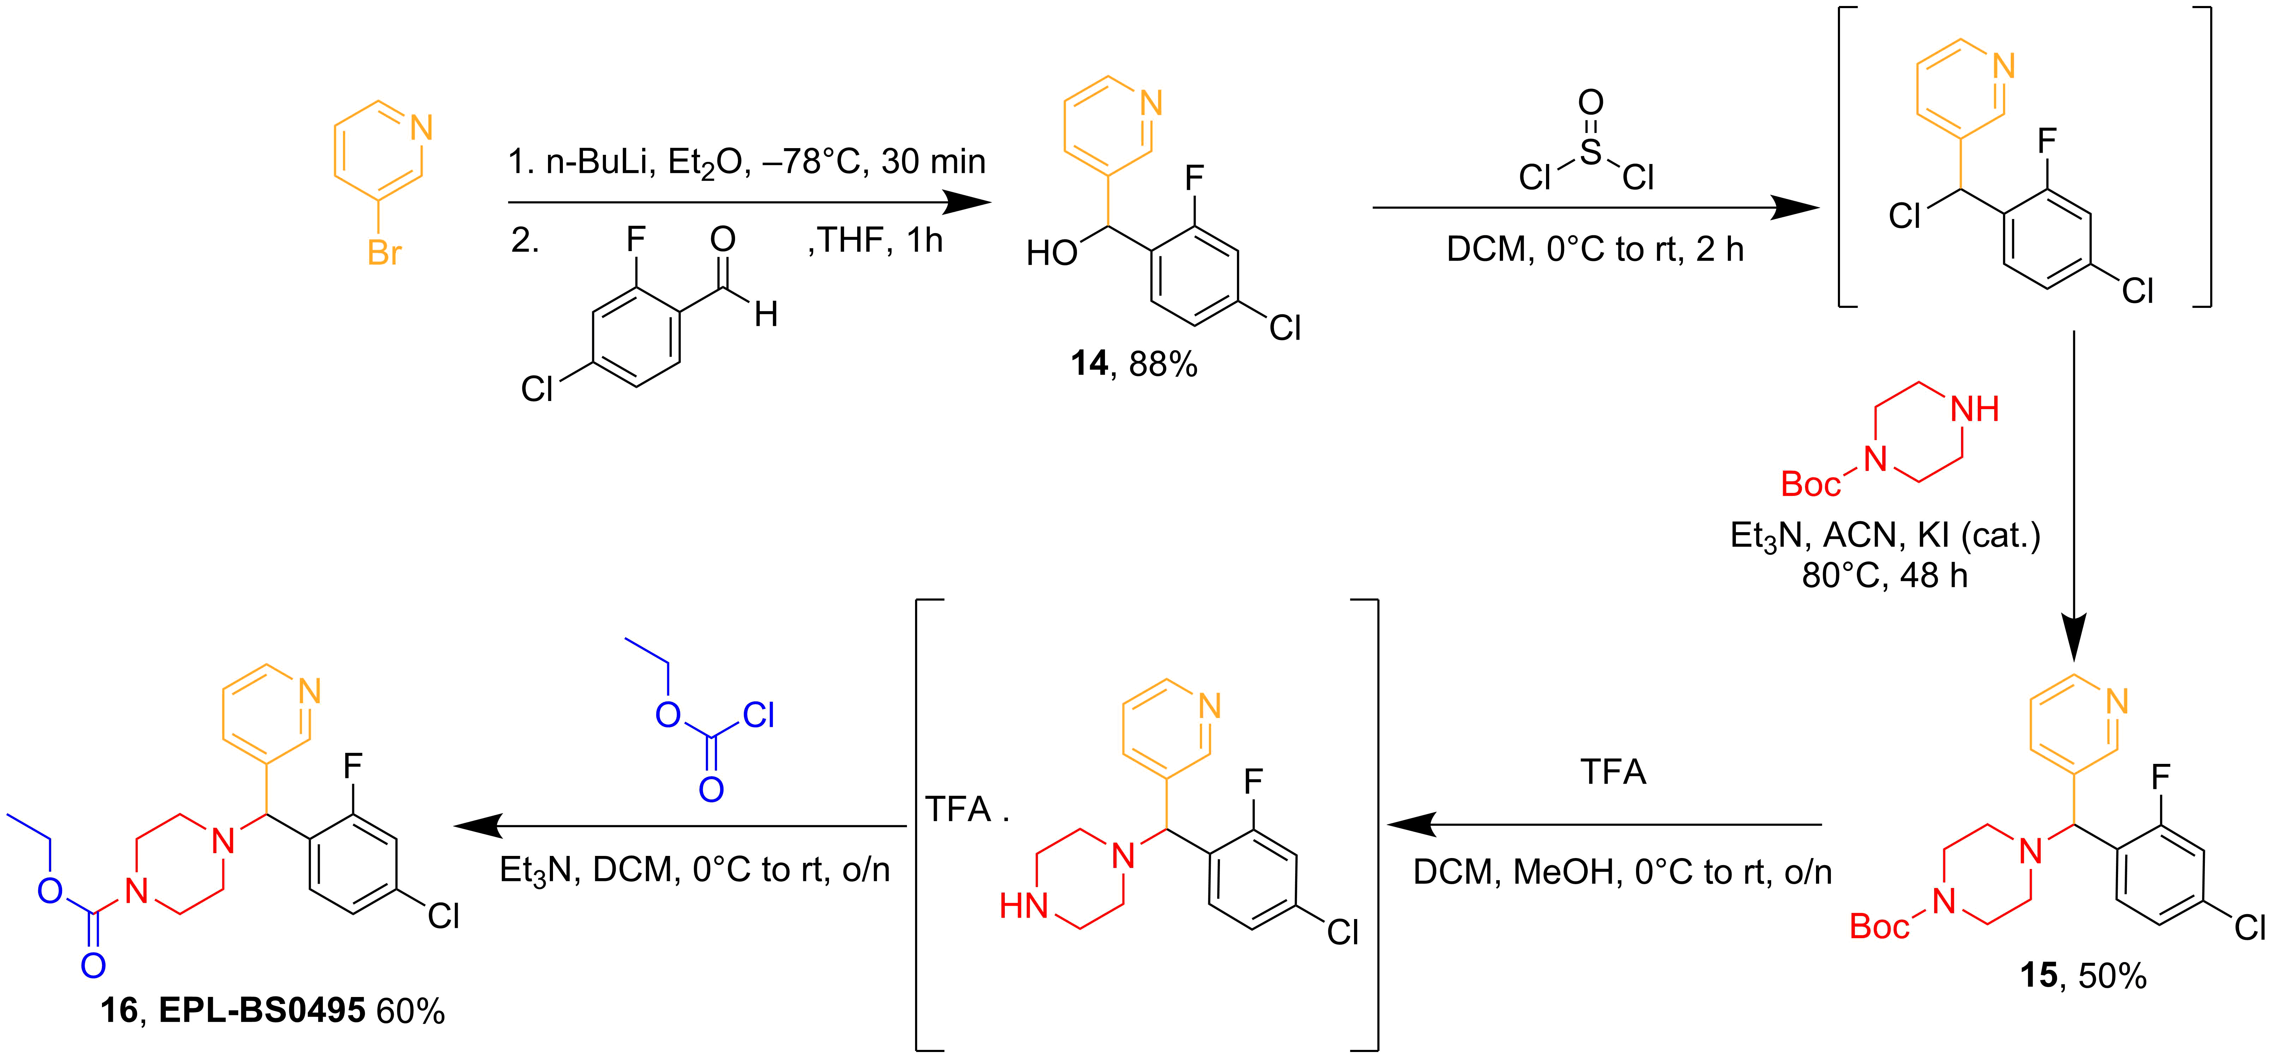
Even More Synthesis
EPL-BS0495 resynthesis

Slide 26
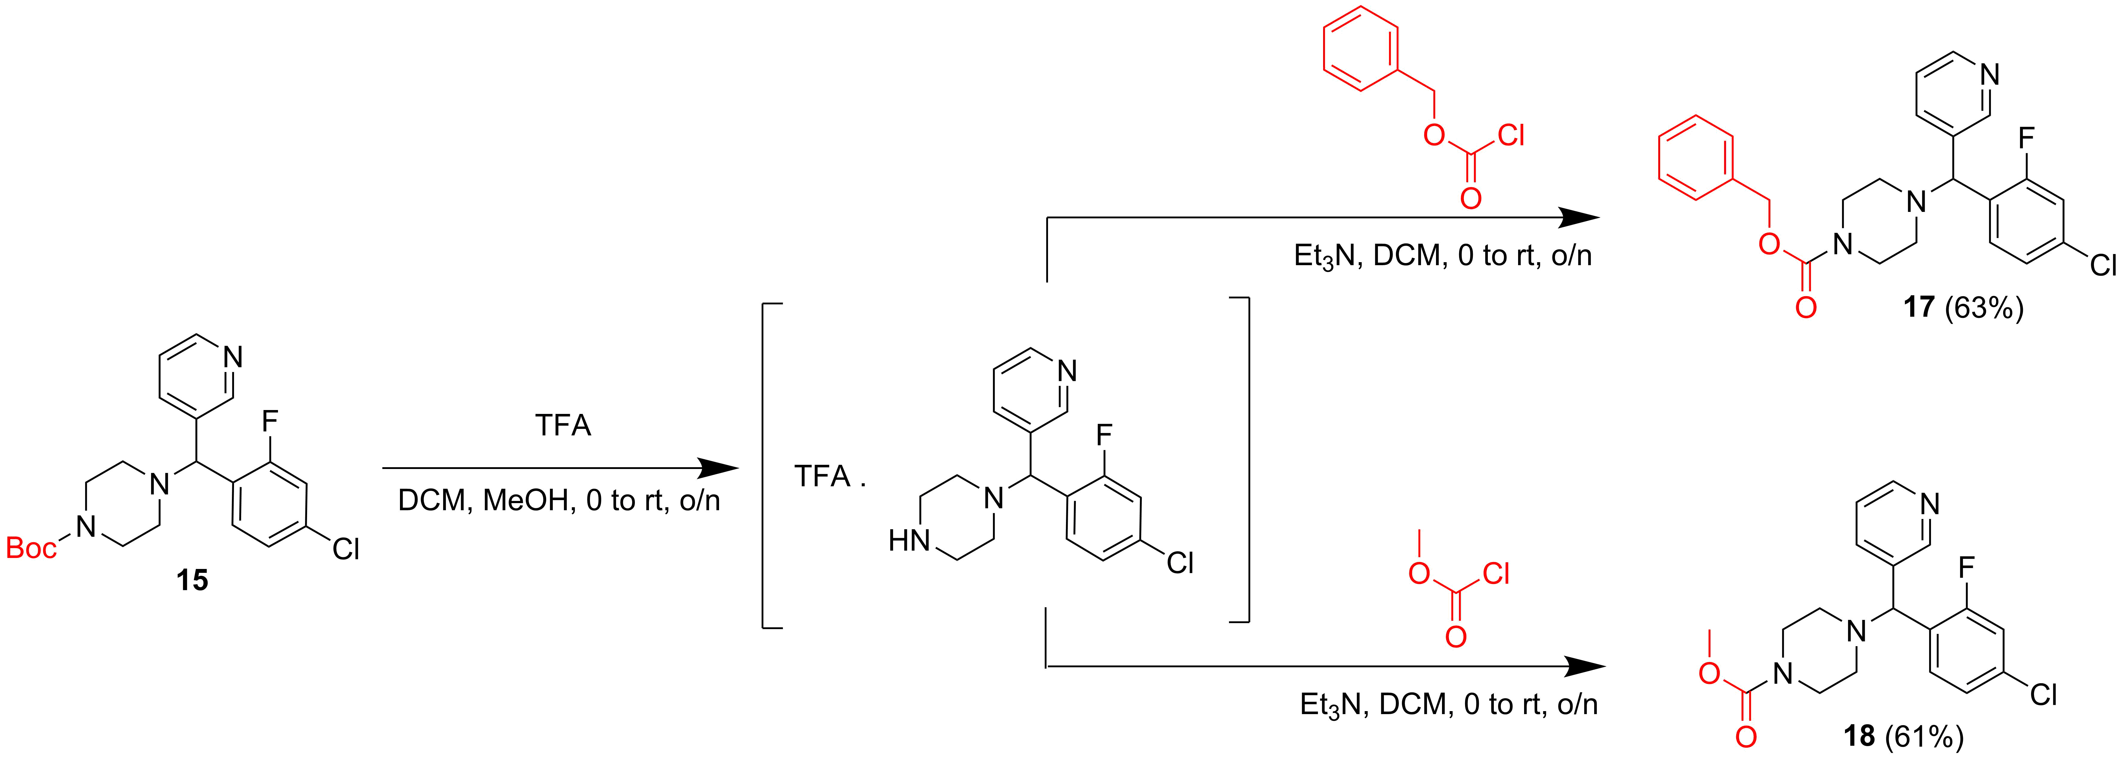
Even More Synthesis
Novel EPL-BS0495 analogues – carbamate mod

Slide 27
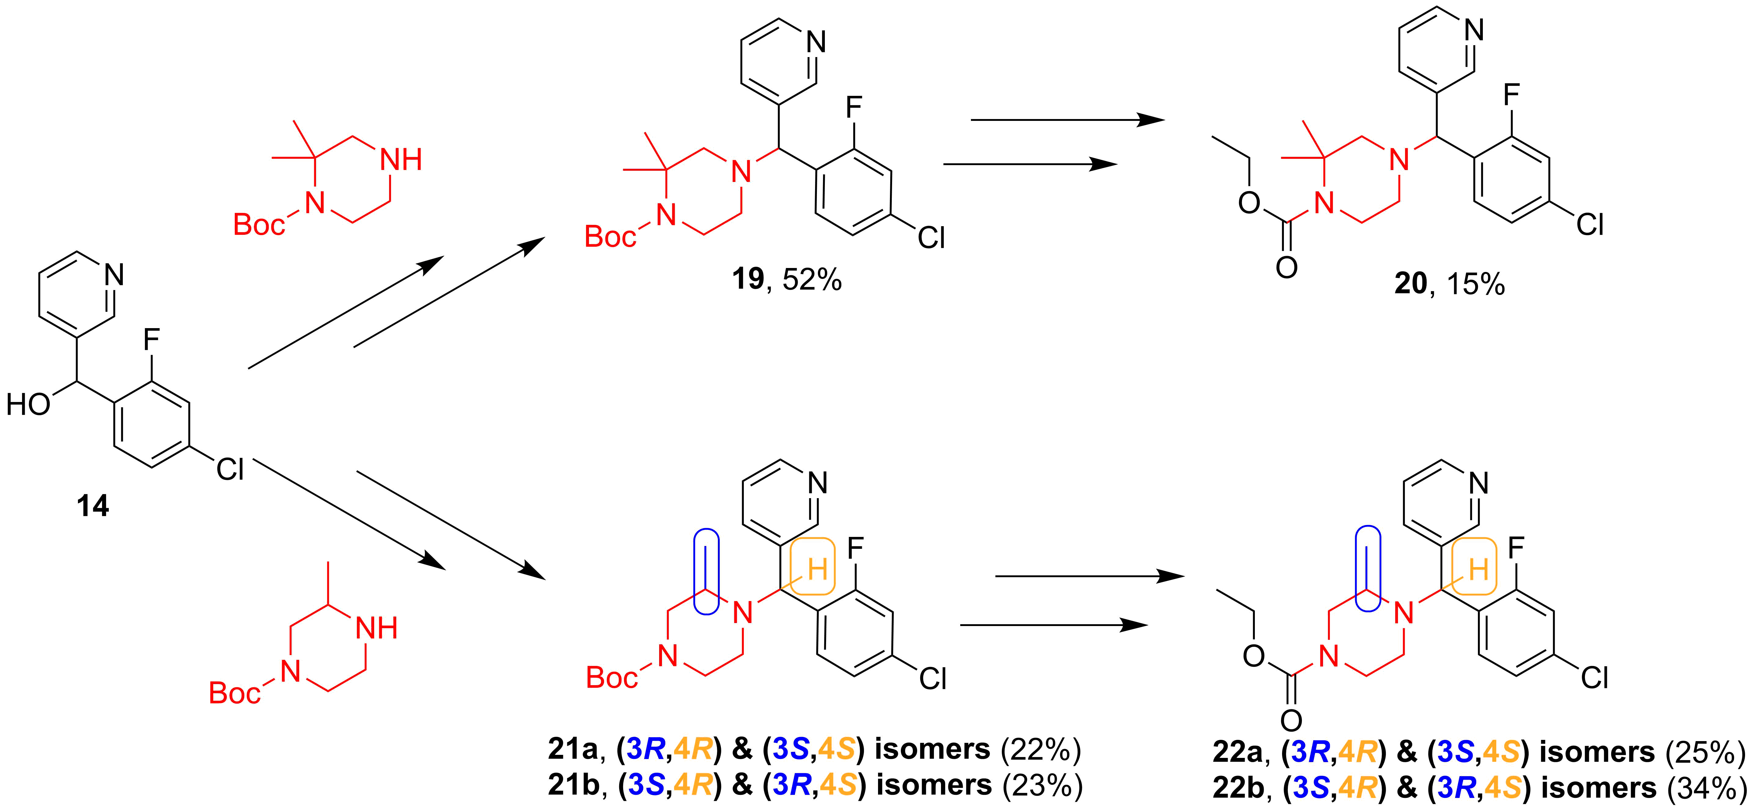
Even More Synthesis
Novel EPL-BS0495 analogues – piperazine mod

Slide 28
Even More Synthesis
Novel EPL-BS0495 analogues – piperazine mod

Slide 29
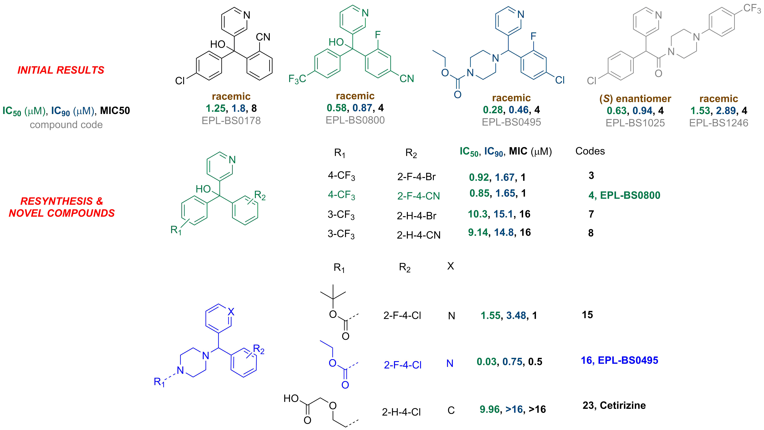
Biological Evaluation
In vitro potency
van de Sande et al. 2017 (unpublished data)

Slide 30
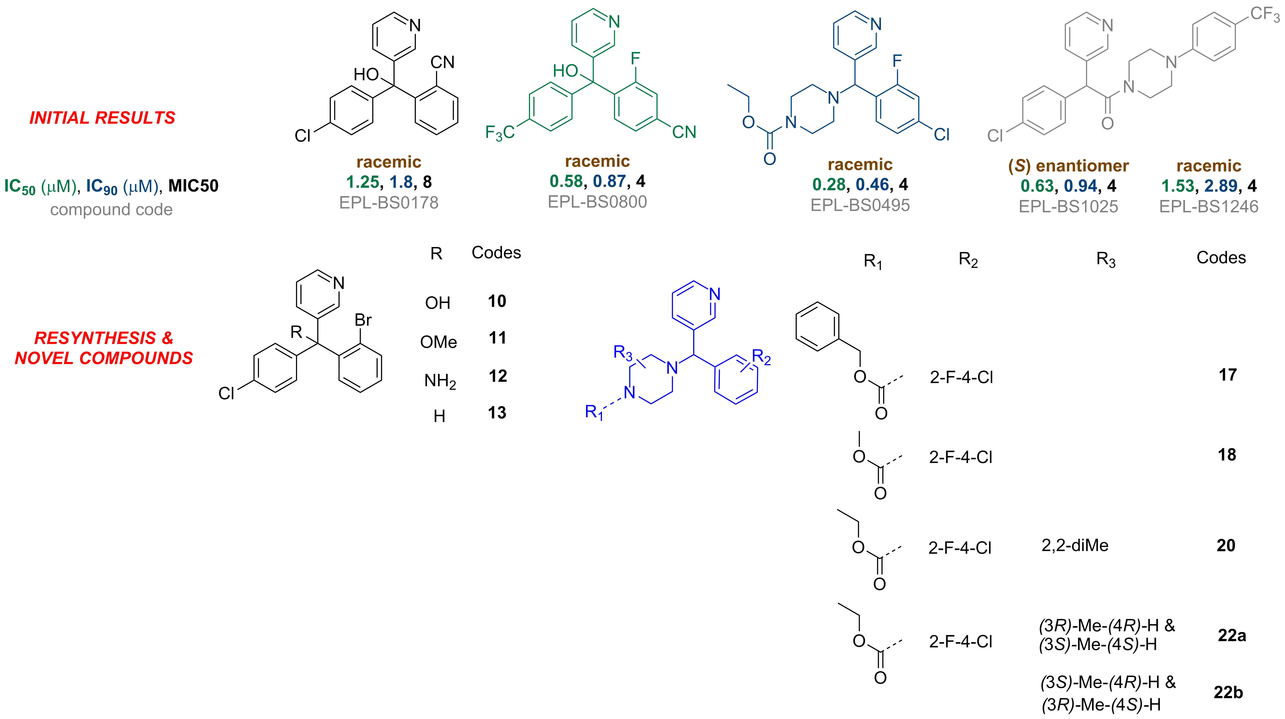
Biological Evaluation
In vitro potency – being tested

Slide 31
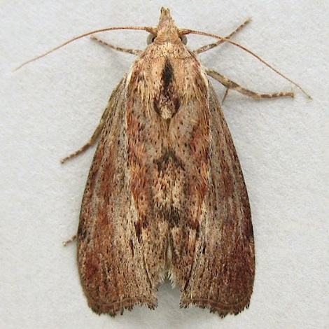
Biological Evaluation
In vivo potency
Wax moth larval model
van de Sande et al. 2017 (unpublished data)

Slide 32
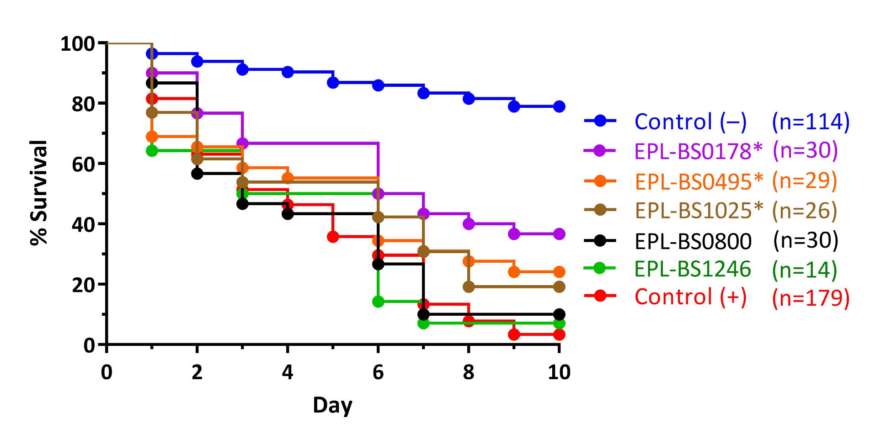
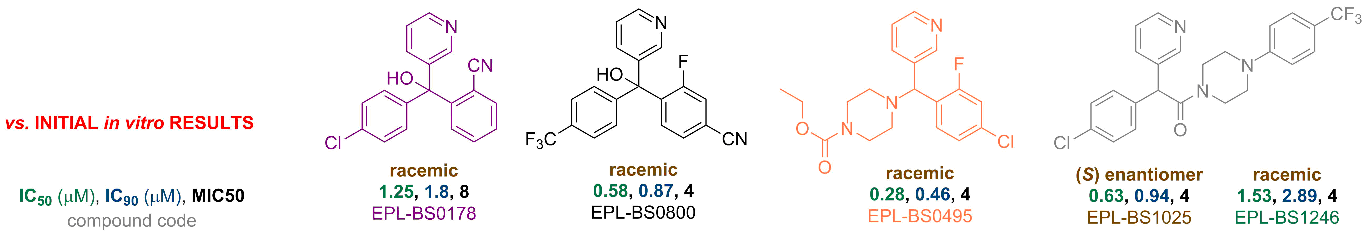
Biological Evaluation
In vivo potency
Wax moth larval model
van de Sande et al. 2017 (unpublished data)

Slide 33
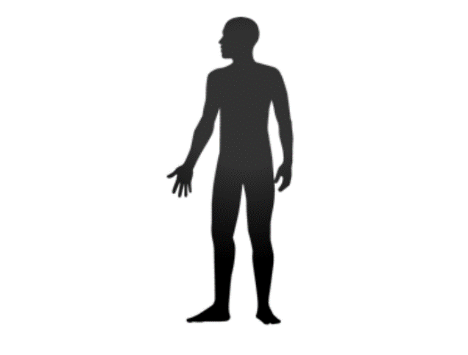
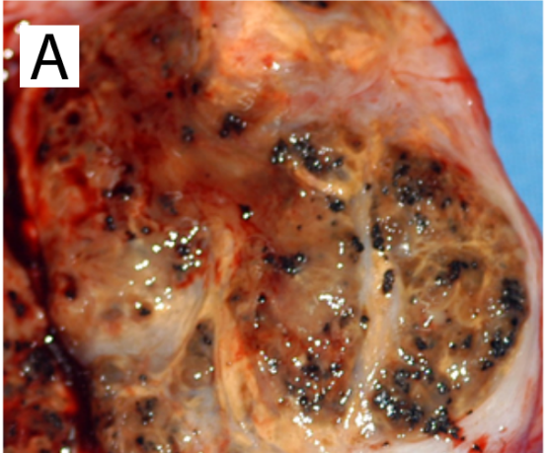
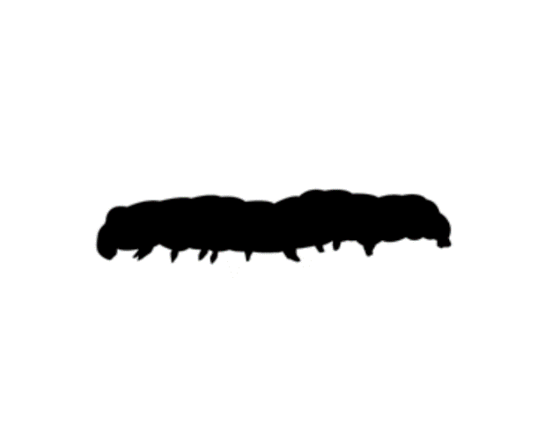
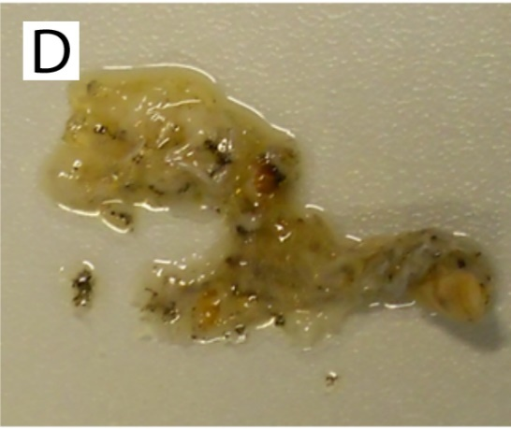
A Unique Challenge
Grain formation in human body
Reproduced with permission from CC-BY-4.0 licence.
Kloezen, W.; van Helvert-van Poppel, M.; Fahal, A. H.; van de Sande, W. W. J., A Madurella mycetomatis Grain Model in Galleria mellonella Larvae. PLOS Neglected Tropical Diseases 2015, 9 (7), e0003926.

Slide 34
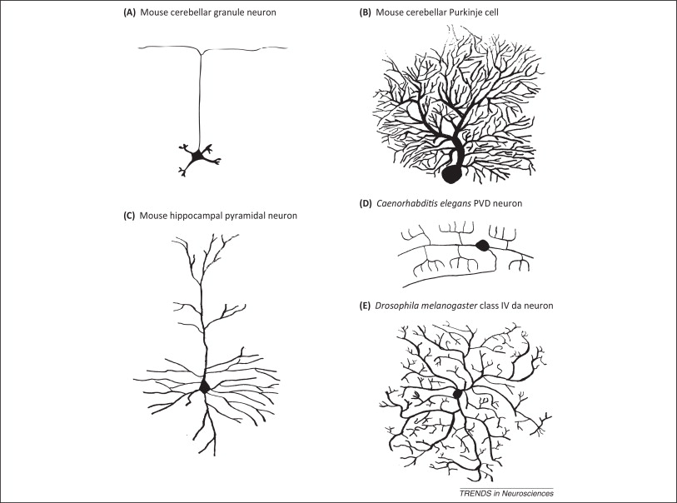
A Unique Challenge
Grain formation in human body
✓
in vitro
✗
in vivo
grain
Reproduced with permission from CC-BY-4.0 licence.
Kloezen, W.; van Helvert-van Poppel, M.; Fahal, A. H.; van de Sande, W. W. J., A Madurella mycetomatis Grain Model in Galleria mellonella Larvae. PLOS Neglected Tropical Diseases 2015, 9 (7), e0003926.

Slide 35
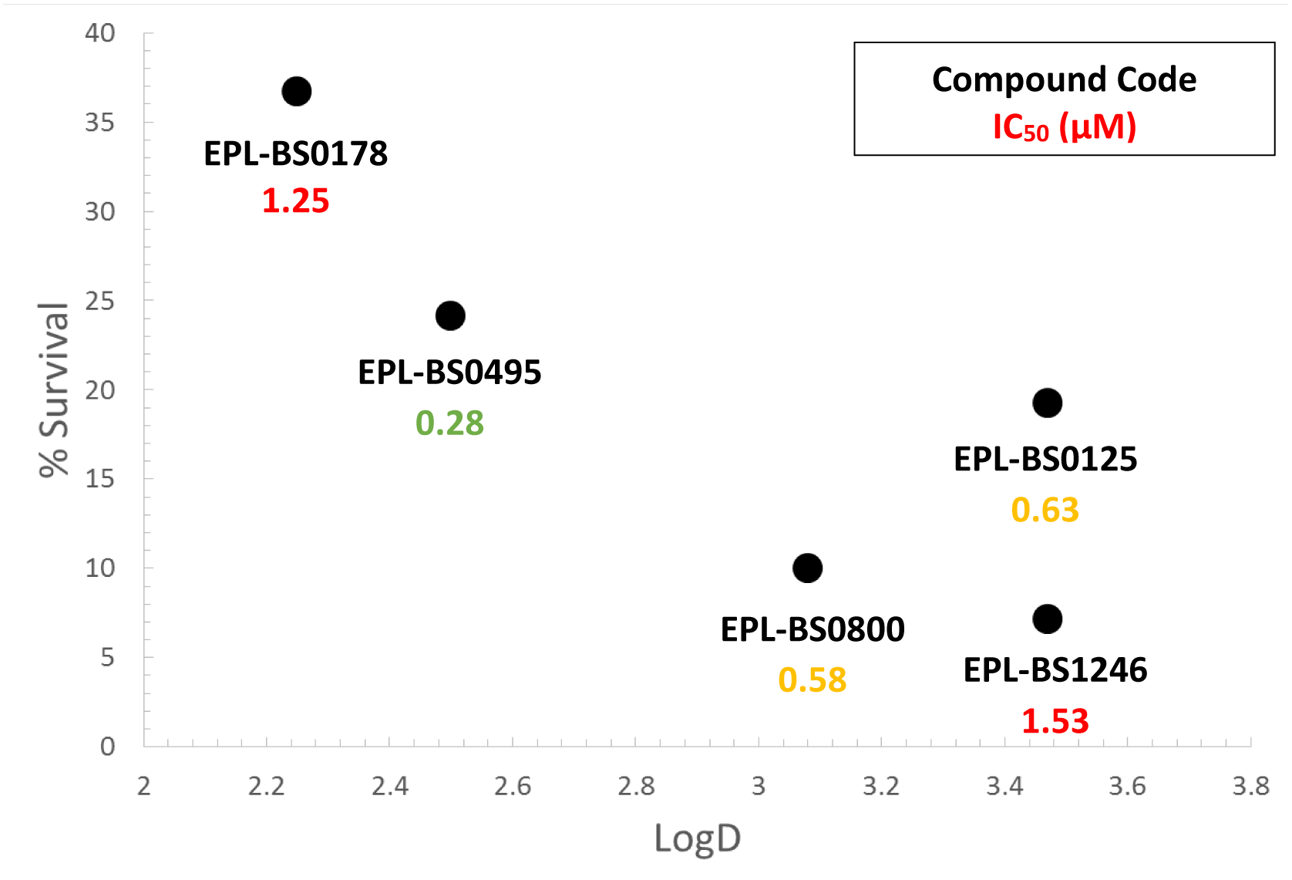
Breakthrough!
In vivo potency correlates with lipophilicity
Dr. Benjamin Perry (unpublished data)

Slide 36
Inception of Open Source Mycetoma

Slide 37
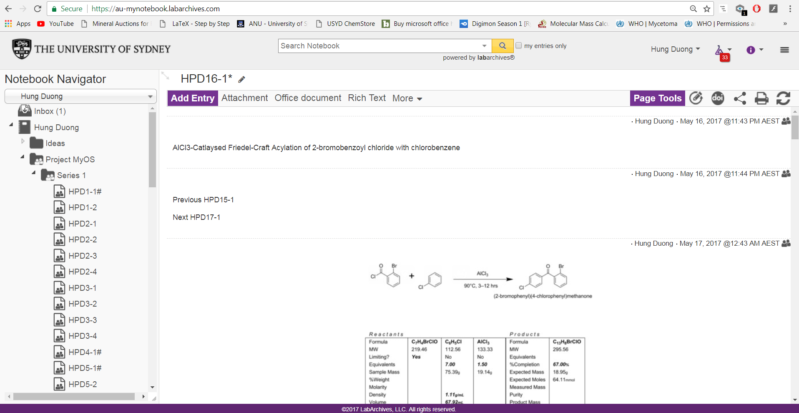
Inception of Open Source Mycetoma
http://tinyurl.com/MyOS-HungELN

Slide 38
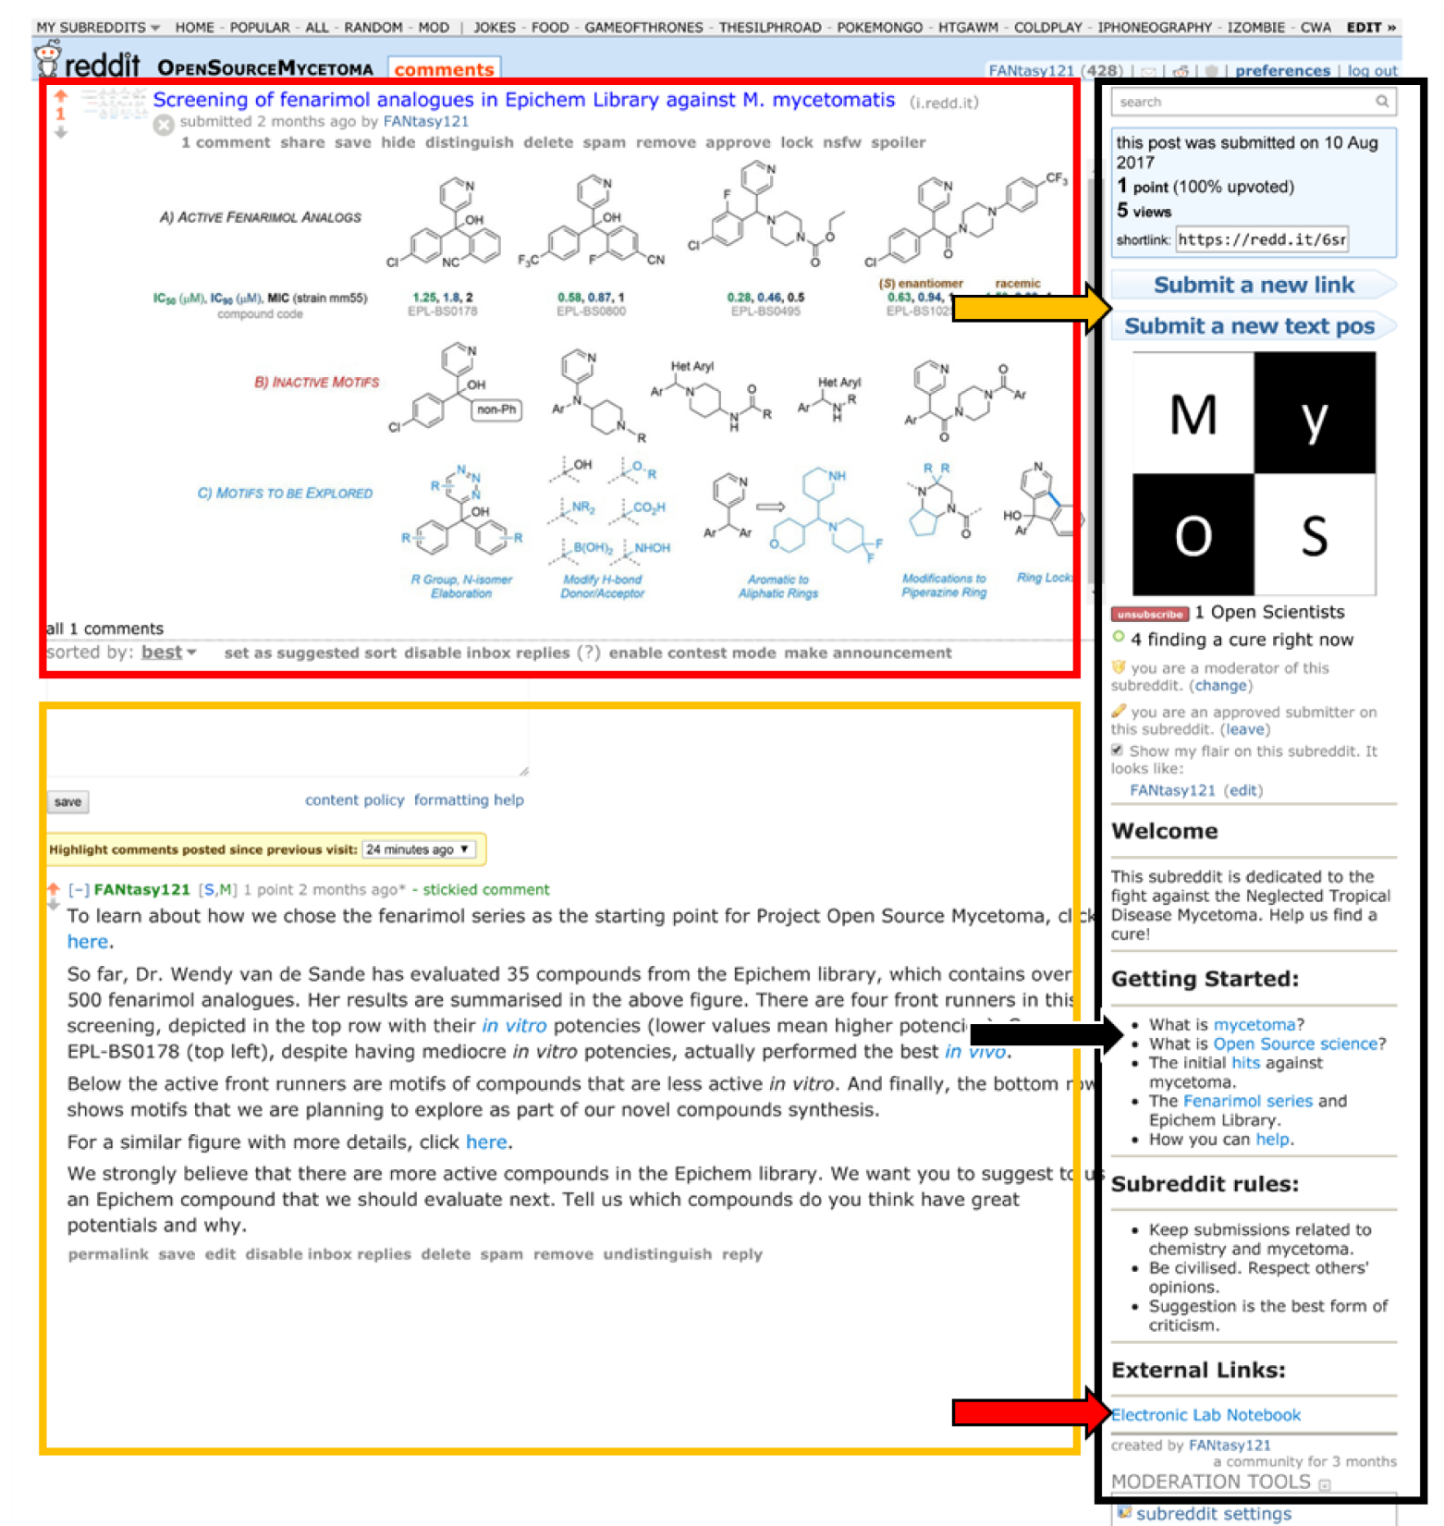
Reddit
r/OpenSourceMycetoma
Opening soon!

Slide 39



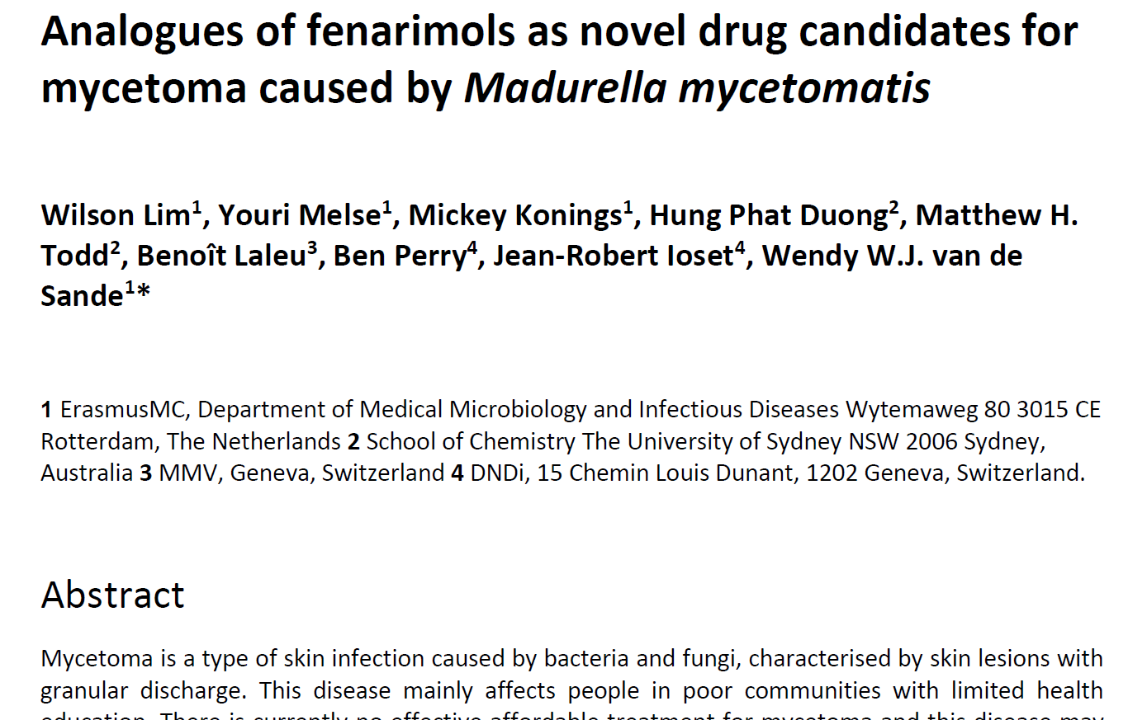
My first journal paper!

Slide 40
Aims
Conclusion
✓✓✓
Resynthesise initial hits
Make novel analogues
✓✓✓
Biological Evaluation
Results guide new synthesis
✓✓✓
Open source platform
Public domain data

Slide 41
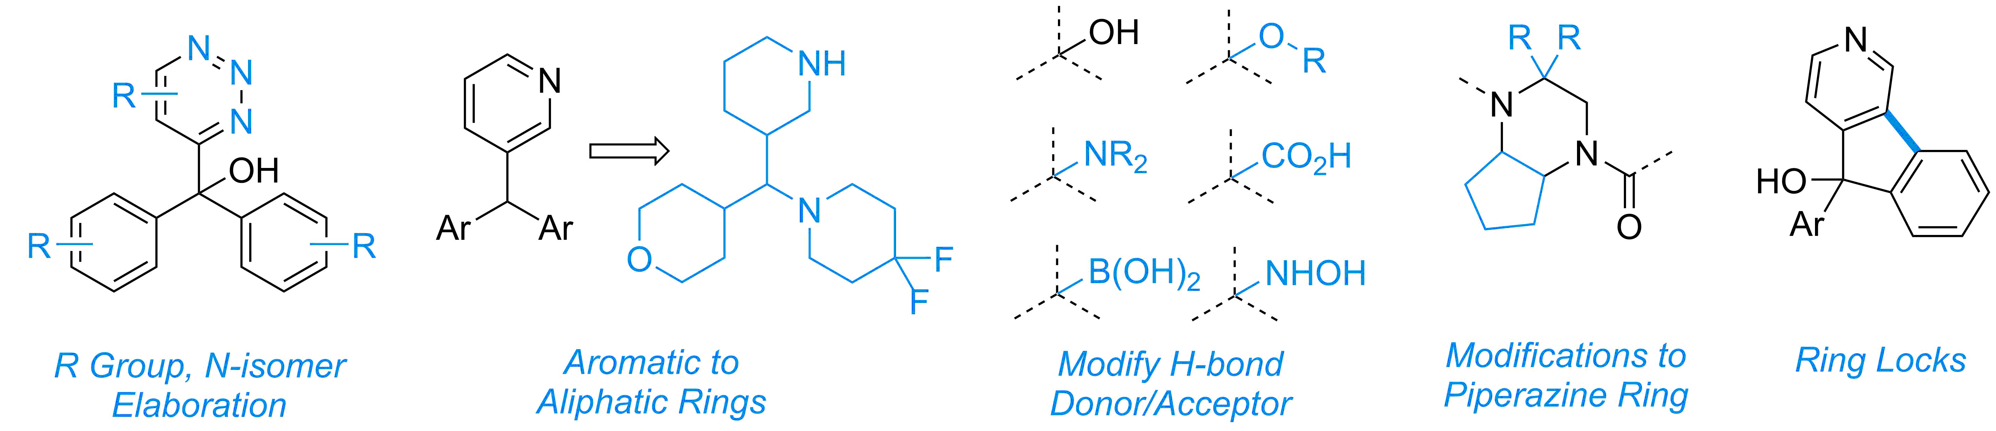
Looking Forward
Many exciting future directions!
Further explore motifs

Slide 42
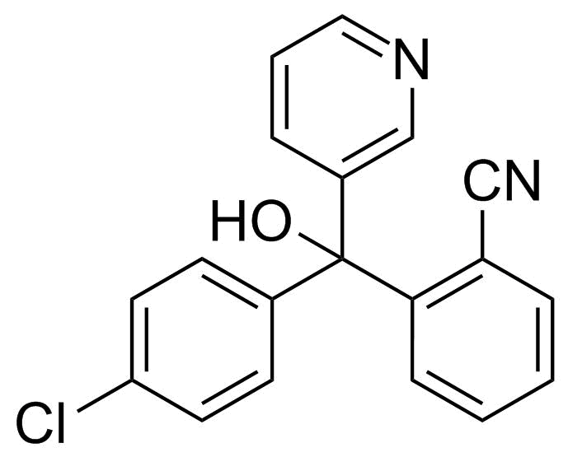
Looking Forward
Many exciting future directions!
Further explore motifs
?
Mechanism of action
grain

Slide 43
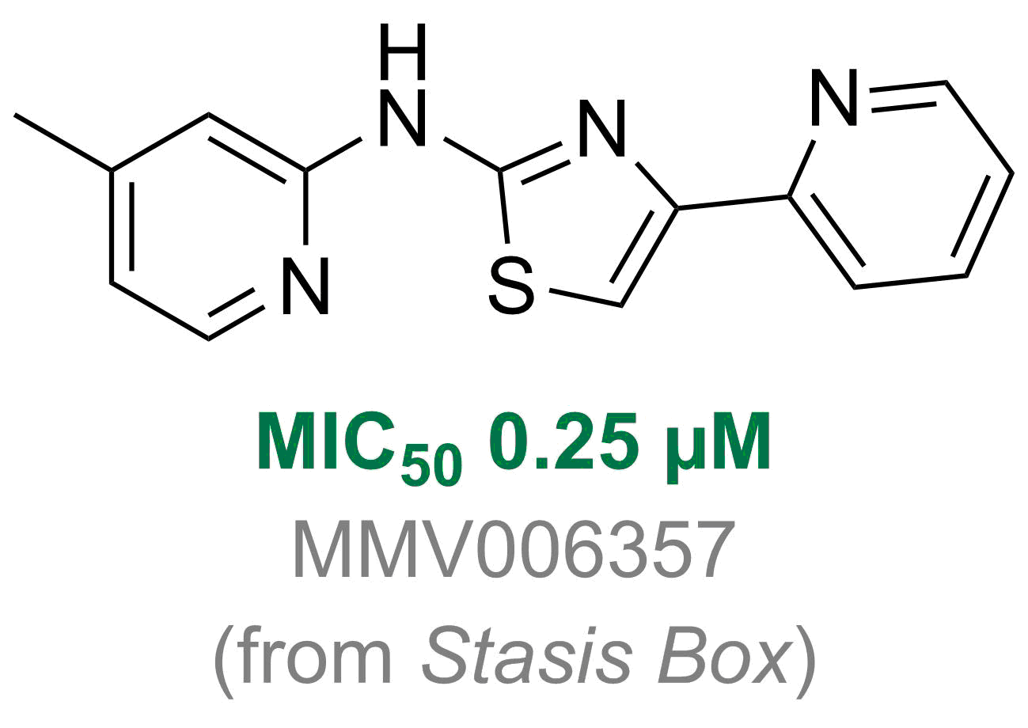
Looking Forward
Many exciting future directions!
Further explore motifs
?
Mechanism of action
Back-up series, new chemical space
grain

Slide 44

Looking Forward
Many exciting future directions!
Further explore motifs
?
Mechanism of action
Back-up series, new chemical space
grain
goes live!

Slide 45
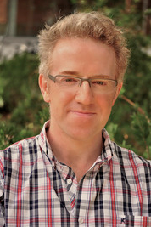
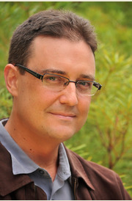
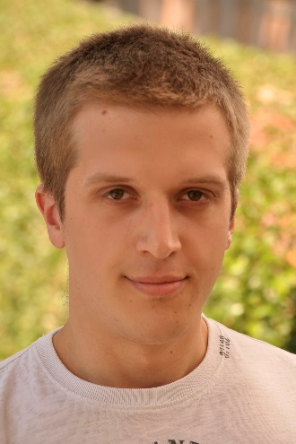
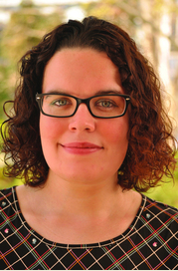
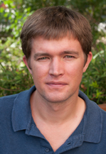
Thank You!
A/Prof Todd
(Supervisor)
A/Prof Rutledge
Dr. Smith
Dr. Williamson
Dr. Spain

Slide 46
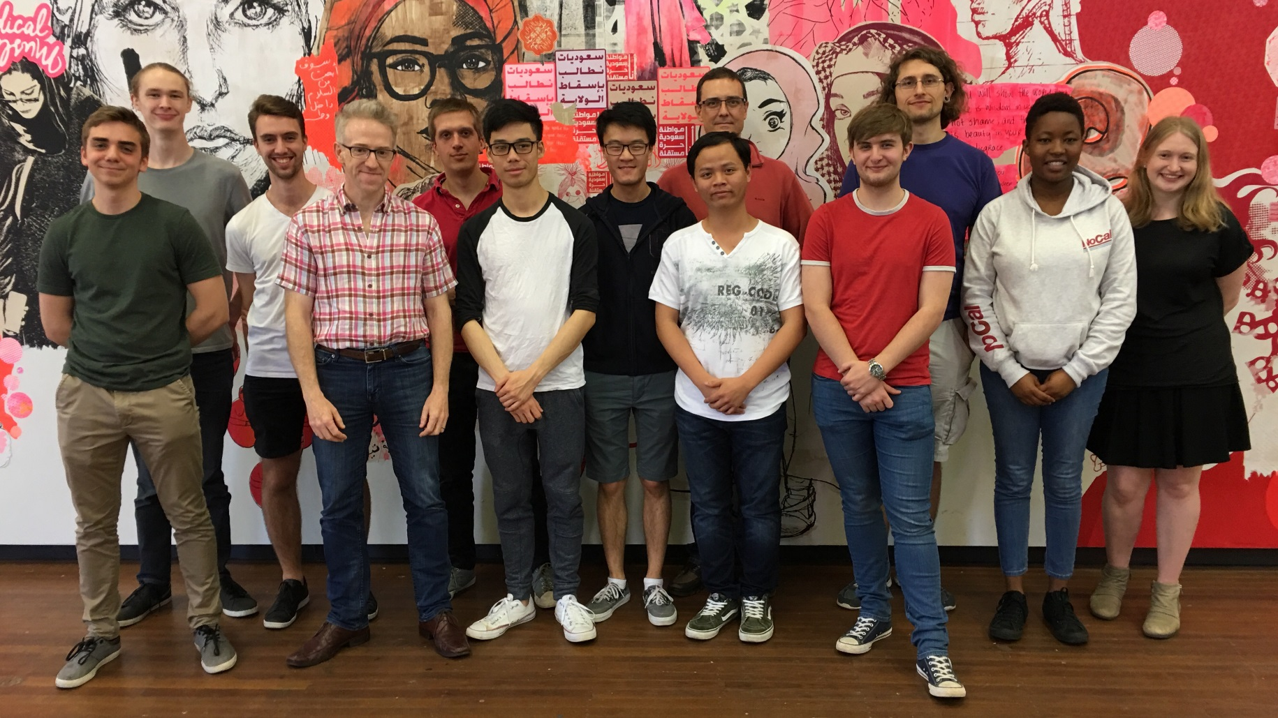
Thank You!
Ed Jamie Paul Tha Nicole Ryan Marat

Slide 47
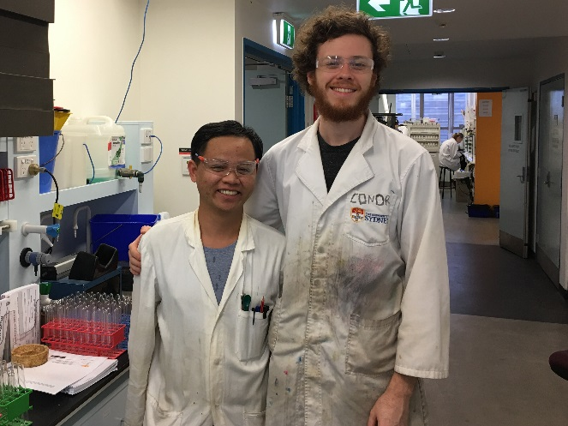
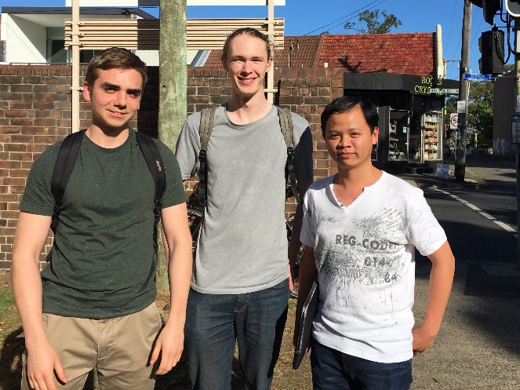
Thank You!
Conor Seb Jack

Slide 49
Back-up Slides and
Anticipated Questions

Slide 50
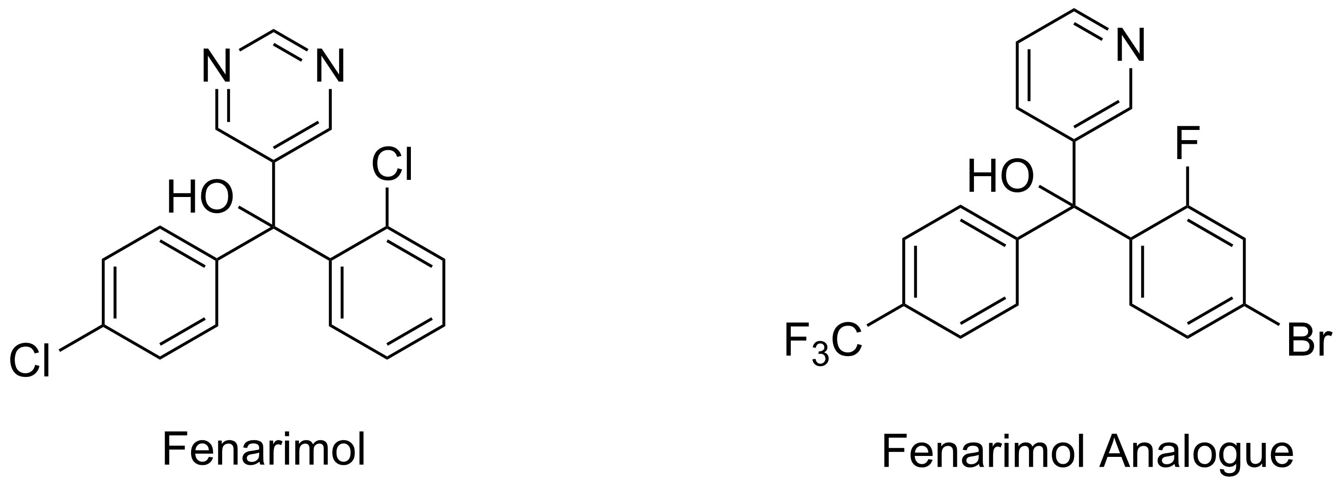
Fenarimol vs. Fenarimol Analogue

Slide 51
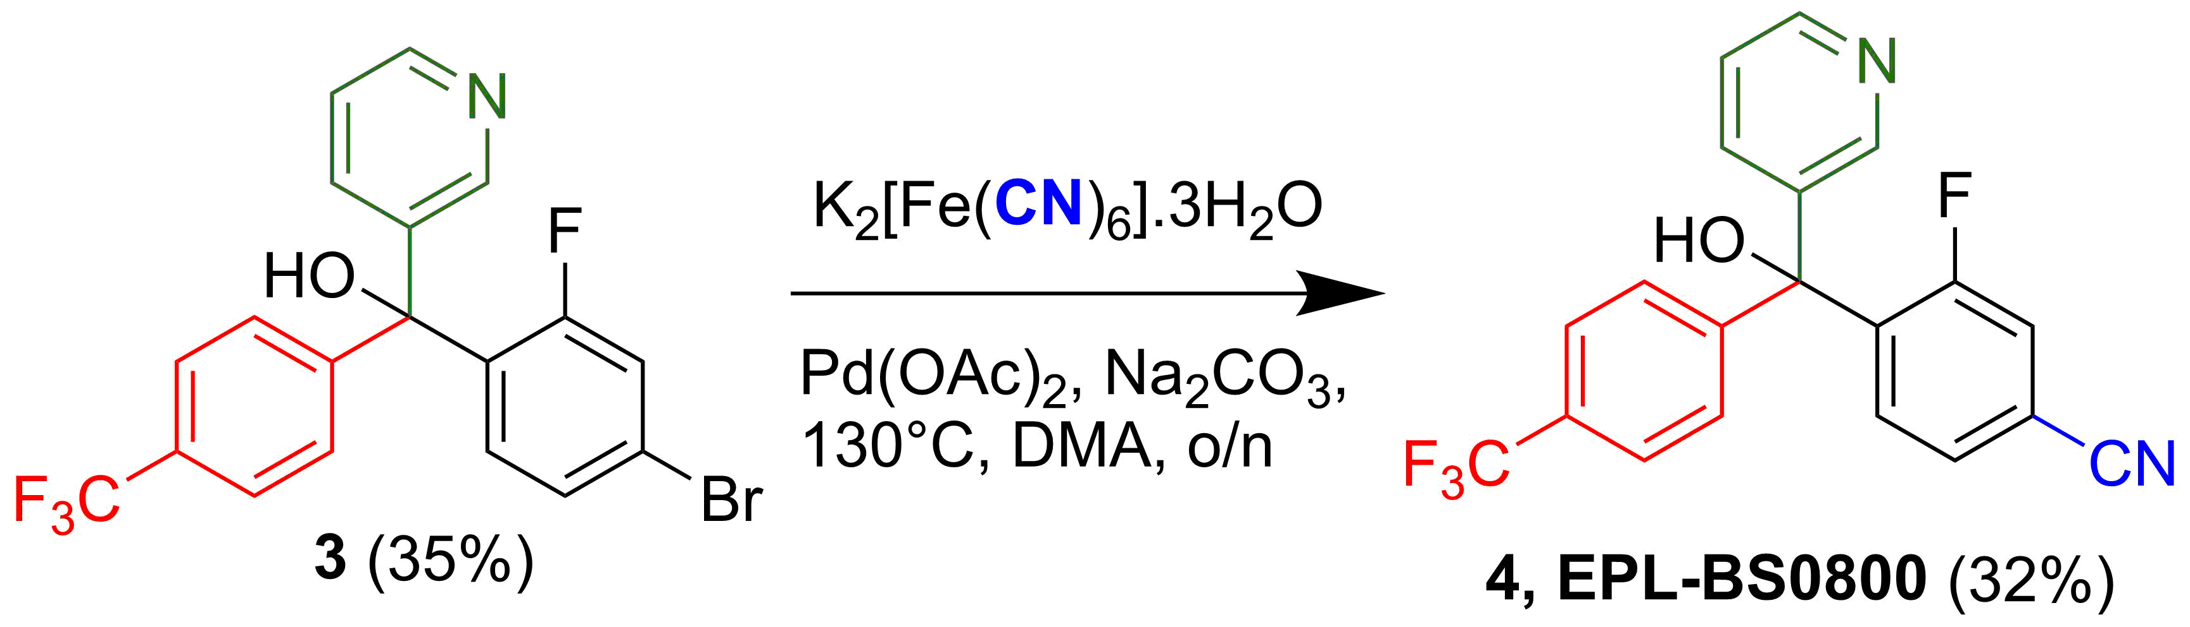
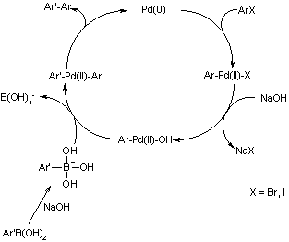
Cyanation Mechanism
Suzuki Reaction

Slide 52
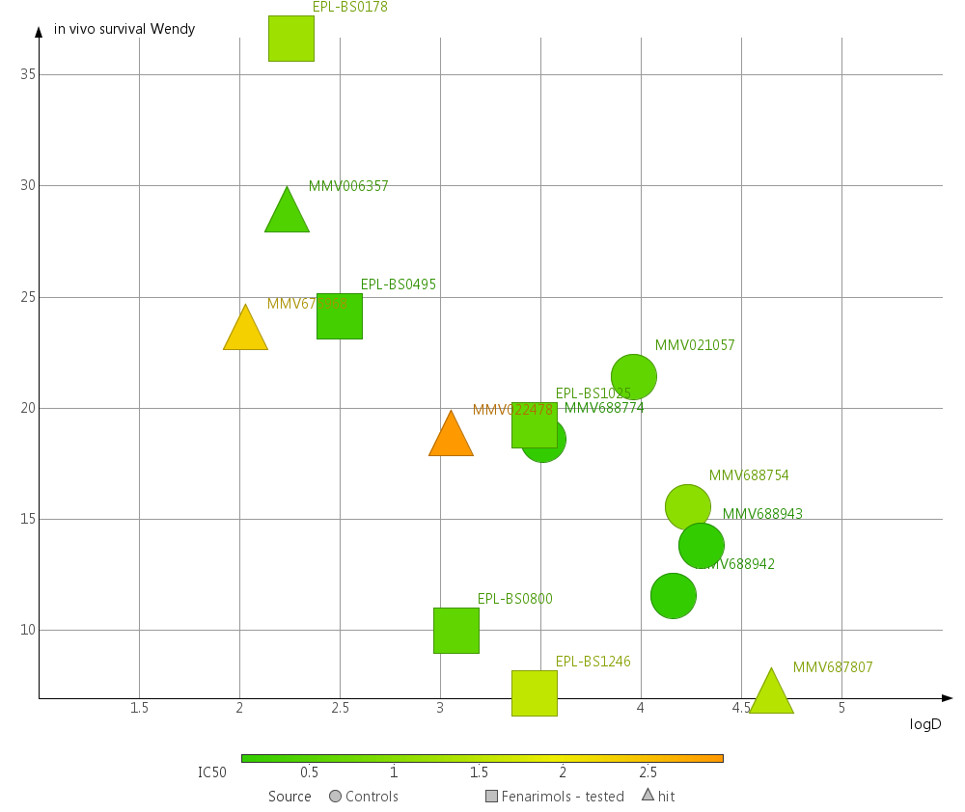
In Vivo vs. LogD Big Picture

Slide 53
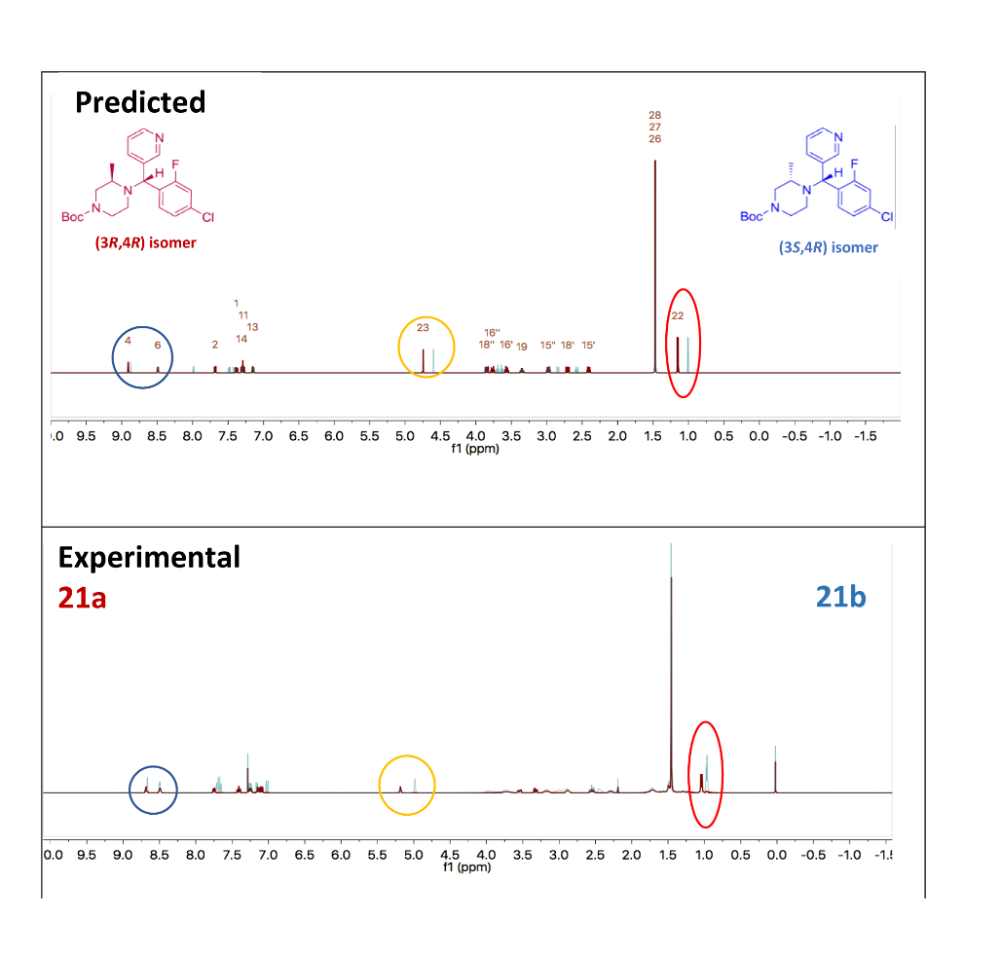

Rationalising The Isomers
Figure 9: RHF/6-31G+(d) optimised structures of models for the (3R,4R) isomer (left column) and the (3S,4R) isomer (right column). (Black=C, white=H, blue=N, red=O; distance (dashed lines) is in Å.

Slide 54

Regioselectivity

Slide 55

Acylation

Slide 56

NaBH₄/TFA

